Slide 1
CLUSTER ANALYSIS K MEANS METHOD

Slide 2
Introduction
Cluster analysis‘ is a class of statistical techniques that can be used to classify objects or cases into groups called clusters.
Objects can be customers, students, stores etc.
A cluster is a group of relatively homogeneous cases or observations.
The observations are dissimilar to objects outside the cluster, particularly objects in other clusters.
Cluster Analysis is one of the unsupervised learning method. There is no concept of “Dependent” variable.

Slide 3
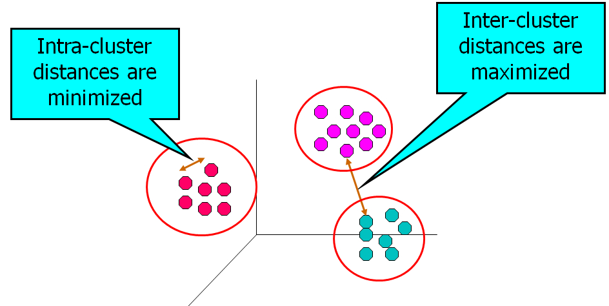
Visualizing Clusters

Slide 4
K- Means clustering method

Slide 5
K-Means Method
K-Means Clustering is one of the most popular non-hierarchical clustering method.
K-Means method is suitable for large data sets and widely used for customer segmentation in BFSI or retail domains.
The number of clusters (k) must be known a priori (though in reality this may not be the case).
Alternatively, cluster solutions can be observed for different k and evaluated to get the best possible cluster solution.

Slide 6
Steps Involved in K-means Clustering
Define K
Define the Distance Measure
Select Initial Seeds
Execute Algorithm
Check the Output for
Cluster Contribution
R-squared
Within and Between Sum of Squares
Repeat the procedure for different K if criterion not satisfied

Slide 7

Distance Measures
Clustering algorithms require a mathematical measure to assess the similarity of a pair of observations or clusters.
Manhattan distance - The sum of the absolute differences in value for each variable ,it is calculated as,
d(x , y) = | a1-b1|+| a2-b2 |+…+| ap-bp |
Chebyshev distance - The maximum absolute difference in values for each variable
d(x , y) =Max ( | ai-bi |)

Slide 8
Distance Measures…
Squared Euclidean distance- The sum of squared differences between values of each variable .
d(x , y) = (a1-b1)²+(a2-b2)²+….+(ap-bp)²
The square root is defined as 'Euclidean Distance'.
'Euclidean Distance' is the most widely used distance measure in cluster analysis.

Slide 9
Choice of Initial Seeds
There are different methods to decide initial seeds. Some of them
are as follows,
K-random observations
First K observations
Last K observations
Partition the data into k partitions randomly and then use the partition mean / median as initial seeds

Slide 10
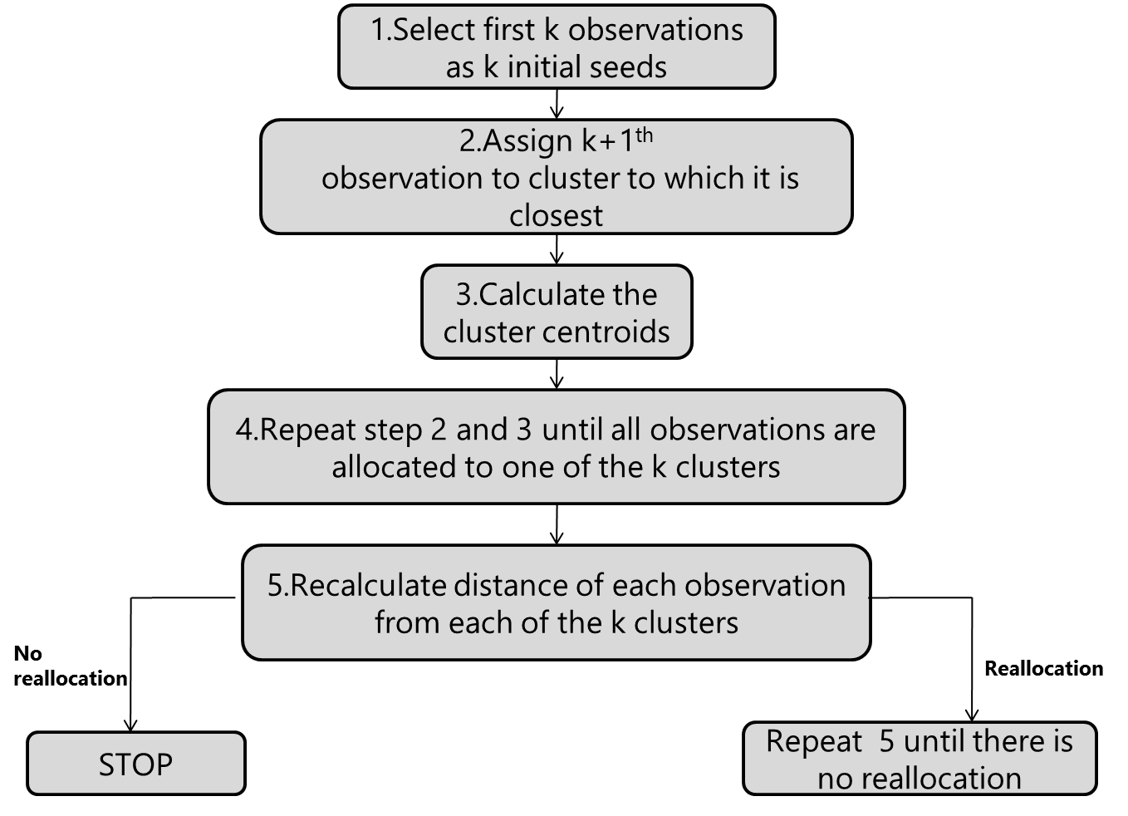
Algorithm

Slide 11
Cluster Analysis: Example for Discussing Algorithm
An insurance co. would like to explore its small town business and create strategies for different groups of small towns.
Insurance data available for the towns are
X1: Loss Ratio
X2: Premium Rates
X3: No. of Policies from that town
Objective is to form two clusters of towns
Town | Loss Ratio | Premium Rates | No. of Policies
A | 1.06 | 9.2 | 151
B | 0.89 | 10.3 | 202
C | 1.43 | 15.4 | 113
D | 1.02 | 11.2 | 168
E | 1.49 | 8.8 | 192
F | 1.32 | 13.5 | 111
G | 1.22 | 12.2 | 175
H | 1.1 | 9.2 | 245

Slide 12
Iteration 1
Data:
K=2 ( It means we are forming 2 clusters of 8 towns)
Step 1 : Initial Seeds
Town | X1 | X2 | X3
A | 1.06 | 9.2 | 151
B | 0.89 | 10.3 | 202
C | 1.43 | 15.4 | 113
D | 1.02 | 11.2 | 168
E | 1.49 | 8.8 | 192
F | 1.32 | 13.5 | 111
G | 1.22 | 12.2 | 175
H | 1.1 | 9.2 | 245

Slide 13
Iteration 1 (contd.)
Step2: Find distance of Town C from A (Cluster1) and B(Cluster2)
Distance of C from A = √(1.43-1.06)²+(15.4-9.2)²+(113-151)² =38.50
Distance of C from B = √(1.43-0.89)²+(15.4-10.3)²+(113-202)² =89.15
Minimum Distance = 38.50
Since distance between town C and town A is minimum, town C will combined with town A.
Updated cluster means are:

Slide 14
Iteration 1 (contd.)
Step3: Find distance of Town D from Cluster1and Cluster2
Here town D will combined with town B (cluster 2)
Updated cluster means are:

Slide 15
Iteration 1 (contd.)
Step 4: Find distance of town E from Cluster 1 and Cluster 2
Here town E will combined with cluster 2(i.e. with towns B & D)
Updated cluster means are:

Slide 16
Iteration 1 (contd.)
Step 5: Find distance of town F from cluster 1 and cluster 2
Here town F will be combined with cluster 1(i.e. with towns A & C).
Updated cluster means are:

Slide 17
Iteration 1 (contd.)
Step 6: Find distance of town G from cluster 1 and cluster 2
Here town G will be combined with cluster 2( i.e with towns B,D & E).
Updated cluster means are:

Slide 18
Iteration 1 (contd.)
Step7 : Find distance of town H from cluster 1 and cluster 2
Here town H will be combined with cluster 2( i.e with towns B,D,E & G).
Updated cluster means are:
Since all the towns are assigned to two clusters, to verify our clusters membership we go for the next iteration.

Slide 19
Iteration 2
In iteration 2, initial seeds will be those two clusters which are obtained at the end of iteration 1.
Step1 :

Slide 20
Iteration 2 (contd.)
Step 2 :- Find the Distance of town A from Cluster 1(i.e from combined towns A,C &F) and then Cluster 2(i.e from combined towns B,D,E,G & H).
Distance of A from Cluster 1 = √(1.06-1.27)²+(9.2-12.7)²+(151-125)² = 26.23536
Distance of A from Cluster 2 = √(1.06-1.44)²+(9.2-10.34)²+(151-196.4) = 45.41439
Minimum Distance = 26.23536
Since distance between town A and cluster 1 is minimum, town A will be retained in cluster 1.

Slide 21
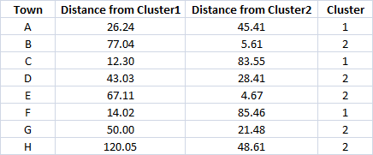
Iteration 2 Summary
No town is reassigned to different cluster.
This is final cluster solution.

Slide 22
Statistics Associated with Cluster Solution
Cluster solution can be assessed using ‘between clusters’ variability and
‘within clusters’ variability.
Within Sum of Squares (WSS) is a measure to explain homogeneity within a cluster.
WSS can be calculated for each cluster and then added to get Total WSS
R-squared is computed as ratio of Between Clusters Variability to
Total Variability.
Total WSS should be small
R-squared should be large

Slide 23
K-Means Method – Some Notes
Standardize variables if scale differs widely. Variables with high variance tend to influence cluster solution. ( Recommended always)
Use data reduction technique like factor analysis before cluster analysis if number of variables is high.
Run the algorithm for different choices of K and initial seeds.
Use dummy variables for nominal scaled variables. K means algorithm is not suited for nominal scaled variables.

Slide 24
K-Means Method in R
Objective is to form clusters of FMCG company customers based on buying behavior.
nsv: Net Sales Value
n_brands: Number of unique brands purchased
n_bills: Number of bills generated
growth: Growth in net sales value
Period: One Year

Slide 25
K-Means Method in R
custsales<-read.csv(file.choose(),header=T)
custsales_cl<-subset(custsales,select=c(-Custid,-region))
#scale (standardize) all variables.(subtract mean and divide by standard deviation)
custsales_cl<-scale(custsales_cl)
CL<-kmeans(custsales_cl,4)
CL
K-means clustering with 4 clusters of sizes 210, 405, 229, 314
Cluster means:
nsv n_brands n_bills growth
1 1.0589762 1.50534917 1.6219927 1.62282815
2 -0.8311329 -0.84045295 -0.7207329 -0.53153606
3 1.1863778 -0.02444231 0.3044816 -0.62581250
4 -0.5014544 0.09508729 -0.3772226 0.05665368
Within cluster sum of squares by cluster:
[1] 732.8205 166.3279 314.9123 145.5306
(between_SS / total_SS = 70.6 %)
Cluster 1 looks platinum customers
group

Slide 26
K-Means Method in R
Append Segment Variable
custsales$segment<-CL$cluster
head(custsales)
Custid nsv n_brands n_bills growth region segment
1 1001 2119456 7 14 -1.79 Mumbai 3
2 1002 1460163 12 42 -1.73 Mumbai 3
3 1003 147976 4 6 2.81 Mumbai 2
4 1004 1350474 13 30 -0.99 Delhi 3
5 1005 1414461 15 29 13.56 Delhi 1
6 1006 2299185 21 49 11.07 Delhi 1
Now segment can be used as any other variable for further analysis.

Slide 27
K-Means Method in R
Summarize Clusters Using Original Variables
aggregate( cbind(nsv,n_brands,n_bills,growth)~segment,data=custsales,FUN=mean)
segment nsv n_brands n_bills growth
1 1875311.4 24.24 48.62 12.28
2 238729.4 4.76 5.79 2.27
3 1985624.2 11.53 24.53 1.84
4 524186.9 12.53 12.07 5.00
Cluster 1 is group of ‘Platinum’ clusters.
Cluster 2 is a group of ‘non-performers’

Slide 28
K-Means Method in R
How to decide number of clusters?
library(factoextra)
fviz_nbclust(custsales_cl, kmeans,method = "wss")
For each k, calculate the total within-cluster sum of square (wss).
Plot the curve of wss according to the number of clusters k.
The location of a bend in the plot is generally
considered as an indicator of the appropriate number of clusters.
Here K= 3 or 4 is a good solution.
The method is termed as Elbow Method.

Slide 29
kmeansruns() in "fpc" Package Finding Best K
Package: fpc: Flexible Procedures for Clustering
Performs K-means method for different values of ‘K’ and provides best value of K.
R commands:
CL1<-kmeansruns(custsales_cl,krange=2:10)
CL1$bestk
# Use this as only indicative.

Slide 30
THANK YOU!!

